Slide 1
Polar Covalent Bonds
Jason R Mayberry

Slide 2
Electron: Particle or Energy
Electrons as Particles
Electrons as Energy
Sometimes it is helpful to think of electrons as particles.
We often envision them orbiting the nucleus, almost like planets around the sun (though this isn’t true).
Sometimes it is helpful to think of electrons as “negative” electrical energy
Their energy is distributed around the nucleus as a cloud of negative charge.

Slide 3
Sharing Energy
What happens to the energy of electrons in a bond?
Ionic
Covalent
Na and Cl in their atomic state
(before bonding).
Two Cl in their atomic state
(before bonding).
Na
Cl
Cl
Cl
This cloud represents only the energy of the electron that will be involved in the bond.
Each cloud represents only the energy of the electron that will be involved in the bond (Color used for clarity)
Both atoms pull on the electron, but Cl pulls much more strongly.
Both atoms pull on the electrons with equal force.
+
–
+
–
Na
Na
Cl
Cl
Cl
Cl
Cl
Cl
Cl gets all the negative charge and becomes an anion; Na becomes a cation.
The energy of both electrons is shared equally between both atoms; no charges.

Slide 4
Polar Covalent Bonds
Ionic
Polar Covalent Bonds
One atoms pulls so much more strongly that all energy of involved electrons is taken entirely.
Clouds represent these electrons.
O
+
–
Na
Cl
H
O pulls the electrons little more strongly than H, but not enough to take electrons away.
Polar Covalent Bonds
Half-way between Ionic and Covalent.
δ–
O
δ–
Non-Polar Covalent
Both atoms pull equally hard so the shared electrons’ energy ends up being shared.
O
δ+
δ+
δ+
δ+
H
H
H
H
O gets most of the energy , but not all, so has a partial negative (δ–) charge;
H looses most but not all, so has a partial positive (δ+)
Cl
Cl

Slide 5
Continuum of Bonding Types
Non-Polar Cov. Bonds
Polar Covalent Bonds
Ionic Bonds
50/50 Sharing
75/25
Unequal Sharing
100/0
No Sharing
And Everything In Between (e.g.: 60/40)
And Everything In Between
(e.g.: 80/20)
Strongest bonds because atoms share electrons in common
Weakest bonds because atoms have nothing in common
Intermediate strength
δ–
+
–
Cl
Cl
O
Na
Cl
δ+
δ+
H
H
Chlorine Gas
Water
Sodium Chloride
δ–
Cl
Cl
δ+
H
O
δ+
Na⁺Cl–
H
*Bond strength experienced in biological systems…which means in bags of water known as cells.

Slide 6
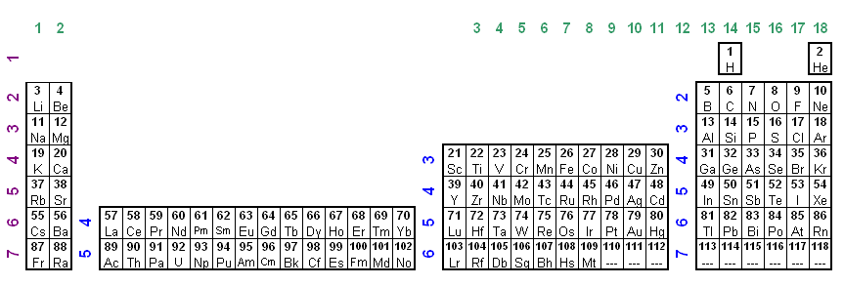
Electronegativity
How do we know how strongly an atom will pull on electrons in a bond?
Electronegativity: Measure of how strongly atoms pull on electrons in a bond (i.e. How badly they want to gain extra electrons)
  The closer an atom is to having its “octet” the more badly it wants more electrons and thus the higher its electronegativity.
  If it is easier to lose electrons to achieve an “octet” the electronegativity will be lower.
*
*
Groups 1 and 2 have low electronegativity
(Fr is the lowest)
Groups 13, 14, and 15 have intermediate electronegativity.
Why is H placed above C?
Groups 16 and 17 have the highest electronegativity
(F is the highest)

Slide 7
Electronegativity
Match the bonds shown to the type of bond they will form:
*
*
C-C
C-H
HCl
KI
NaCl
NaI
N-H
O=O
O-H
S-H
Electronegativities are the same ➔
Equal Sharing of Electrons ➔ Non-Polar Cov. Bonds
Electronegativities are somewhat different ➔
Unequal Sharing ➔ Polar Cov. Bonds
Electronegativities are very different ➔
Give/Take➔ Ionic Bonds

Slide 8
Electronegativity
How does the relative electronegativity of two atoms affect the bond they form?
Electronegativities are the same ➔ Equal Sharing of Electrons ➔ Non-Polar Cov Bonds
Electronegativities are somewhat different ➔ Unequal Sharing ➔ Polar Cov. Bonds
Electronegativities are very different ➔ Give/Take➔ Ionic Bonds
*
*
Memorize these answers, and make sure you can explain them.
Non-Polar Cov.
Polar Covalent
Ionic
C-H
O=O
C-C
O-H
N-H
HCl
NaCl
NaI
KI

Slide 9
Electronegativity Summary
Electronegativity: Measure of how strongly atoms pull on electrons in a bond (i.e. How badly they want to gain extra electrons)
*
*
Atoms with low electronegativity
  Will always lose electrons and become positively charged (cationic)
  They do not have enough valence electrons to have their desires met by sharing
Atoms with a middle electronegativity
  Will always form covalent bonds (polar or nonpolar depending on the partner)
  The charge would be too great for them to gain or lose electrons to make ionic bonds
Atoms with high electronegativity do whatever the molecule they are bound with wants (notice that some periodic tables put H and He on the right side just for this reason
Hydrogen
  Electronegativity is almost the same as Carbon
  Will generally form ionic bonds with group 17, Polar Covalent with groups 15 and 16, and Non-polar Covalent groups 5 and 6.

